Slide 2

Luke 14:16-24

Slide 3
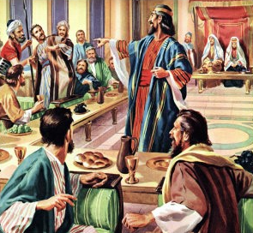
THE BIG FEAST
Luke 14:16-24
2 Corinthians 6:2 “Behold, now is the accepted time”
Ephesians 3:8-12
“the mystery which from the beginning of the ages has been hidden in God”
“according to the eternal purpose which He accomplished in Christ Jesus our Lord.”

Slide 4
THEY ALL WITH ONE ACCORD BEGAN TO MAKE EXCUSES
Luke 1:18
First Man- “I have bought a piece of ground, and I must go and see it. I ask you to have me excused.”
Materialism- Matthew 6:19-21
Second Man- “I have bought five yoke of oxen, and I am going to test them. I ask you to have me excused.”
Business Minded – 1 Timothy 6:9-11

Slide 5
THEY ALL WITH ONE ACCORD BEGAN TO MAKE EXCUSES
The Third Man – “I have married a wife, and therefore I cannot come.”
“It is impossible for me to come”
“JUST MARRIED” Used family as an excuse to avoid obligation
Matthew 10:34,37
The Punishment – vv. 21-24

Slide 6
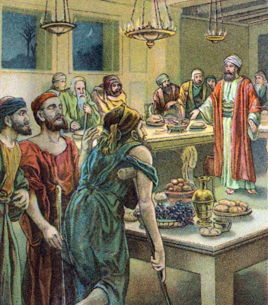
THE PARABLE OF THE MARRIAGE FEAST
Matthew 22:1-14
The King is God
First set of those Invited – Matthew 23:29-32
Slaves are Sent to seek More Guests – Great commission

Slide 7
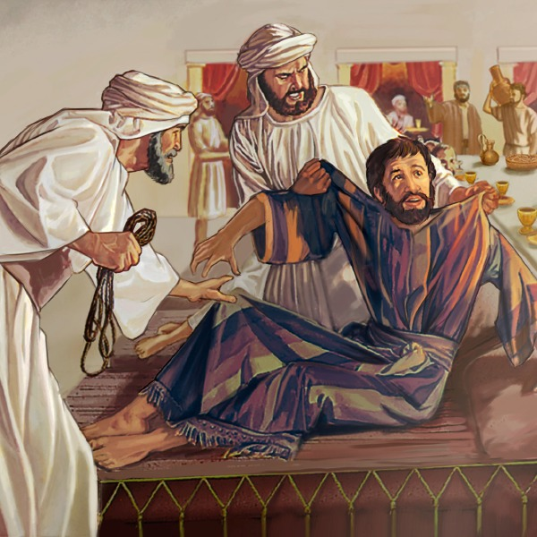
ONE NOT DRESSED PROPERLY
Matthew 22:11-14
Every saint is robed in the white robes of Christ’s righteousness
Galatians 3:27
Ephesians 4:22-24

Slide 8
THE INVITATION
DO YOU RELY ON EXCUSES OR WILL YOU ACCEPT THE CALL?
THE WORK IS THERE – THE COMMITMENT TO BE MADE
WILL YOU MAKE IT OR MAKE EXCUSES?

